Slide 1

Introduction
to
Cyber Security

Slide 2
Structure of presentation
Introduction
Our Best friends.
Branches
Some Actions……
--------------
--------------
--------------

Slide 3
Is it illegal ?? Yes/No
Is it moral??? Mostly No
Can go to jail?? Yes
Is it fun?? Hell yeah

Slide 4
Our best friends:
Linux (Kali)
Github
Google dorks
Online and offline tools
And of course, Firefox.

Slide 5
Branches of hacking
Web Security
Cryptography
Network Security
Exploitation
Forensics
Reversing
.....
Notes:
Created to add some logical parts on the websites, called as a script language - executed with help of script engines like V8 on chrome and opera- spidermonkey or chakra..
Things JS can do on page:
Add new HTML to the page, change the existing content, modify styles.
React to user actions, run on mouse clicks, pointer movements, key presses.
Send requests over the network to remote servers, download and upload files (so-called AJAX and COMET technologies).
Get and set cookies, ask questions to the visitor, show messages.
Remember the data on the client-side (“local storage”).

Slide 6
Tools to be used today
Kali 2018.4
Firefox ( Best browser ); Chrome sucks ;(
Nmap- Network Scanning tool
Wireshark- Capture traffic
BurpSuite- Intercepts traffic

Slide 7
Hacking Process
Main aim :
To gain root access to a system…

Slide 8
How….???

Slide 9
What do we get by doing this…???
Any Guess..??

Slide 10
Everything.
Everything means everything…

Slide 11
Access any file in that system.
Open webcam
We can get all saved password. From browsers too.
Steal saved credit card information
Use his internet connection for our use ( yeah badsites too)
We can use his IP for doing bad activities.
Can change your attendance
Can use his computer for bitcoin mining
…….. and much more

Slide 12
Lastly
Most importantly clear logs and tracks
Example clear all terminal history by
Script kiddies: history –c -w
Hardcore
Microwave hard disk, then destroy by drilling

Slide 13
Information Gathering
Network scanning
Services running
ssh 22
http 80
https 443
tcp
DNS scanning
Server Version and services

Slide 14
CRYPT0GR4PHY
The art of writing or solving codes...

Slide 15
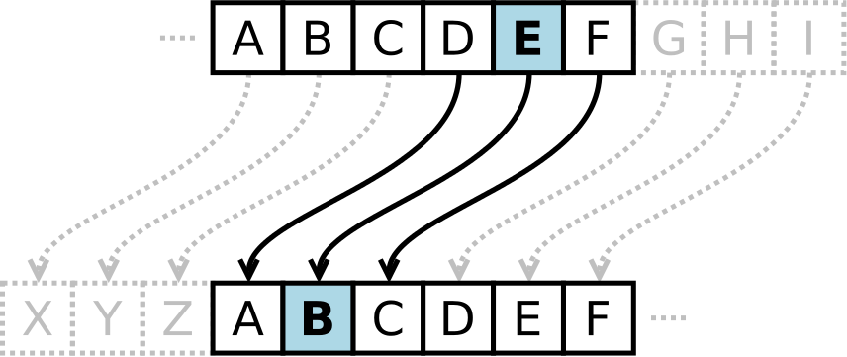
Caesar Cipher
It is a type of substitution cipher in which each letter in the plaintext is replaced by a letter some fixed number of positions down the alphabet
Eg:
cyberlabs => hdgjwqfgx
how??
shift by +5 c=>h

Slide 16
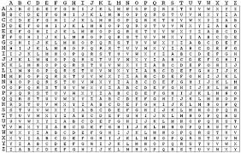
Vigenere Cipher It is s a method of encrypting alphabetic text by using a series of interwoven Caesar ciphers, based on the letters of a keyword
Plaintext: | ATTACKATDAWN
Key: | IOZQGHIOZQGH
Ciphertext: | IHSQIRIHCQCU

Slide 17
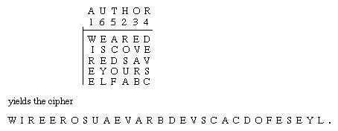
Transposition Cipher
a transposition cipher is a method of encryption by which the positions held by units of plaintext (which are commonly characters or groups of characters) are shifted according to a regular system, so that the ciphertext constitutes a permutation of the plaintext
Plaintext, Key and dimensions of the rectangle (n*m)
If n*m<len(plaintext) fill the remaining by ABC…..

Slide 18
Attacking ciphers
Brute force
Try all possible combinations
Works when the size of password is know and the alphabet set is also known
Sometimes not feasible due to lack of computation power
Tools- johntheripper, hydra, metaspolit, cryptool
Operations on Intel-i3 processor/sec ~ 20mil (C++)

Slide 19
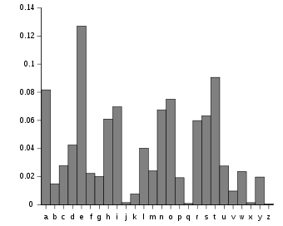
Frequency analysis
Use the fact that the plaintext is in English
Some letter are more common than other letter
Works only on a substitution cipher

Slide 20
Further resources…
http://www.crypto-it.net/
https://cryptii.com/

Slide 21
Try to decrypt this at home.
comebsdi sc tecd kx svvecsyx…!!!

Slide 22
Web Hacking…

Slide 23
Lets again start by gathering information:
What Information…???

Slide 24
Web Vulnerabilities
Some Important One:
Cross Site Scripting(XSS)
Refected XSS
Stored XSS
DOM Based XSS
Injection-SQL, OS, Command Injection
Examples:
Cmdi: natas(OTW): level – 9
Sqli: natas(OTW): level – 14
Notes:
‹#›

Slide 25
Find IP of site by pinging ping anywebsite.com
Find Subdomains Visit- Virustotal.com and search the site.
Find what programming languages they are using :
Method 1: Using Google dorks
Search on google : site:facebook.com .php
site:google.com .php/.jsp
Method 2: By Kali Linux:
whatweb anywebsite.com
- in that: x powered by gives programming language used.

Slide 26
Now some actions…

Slide 27
PHISHING…..???
The act of sending an email to a user falsely claiming to be an attempt to scam the user into surrounding private information that will be used for identity theft.
Lets see this live…

Slide 28
Lets try on Live site:
https://www.anywebsite.com/search.jsp?searchkey=%22%3E%3Cscript%3Ealert(1)%3C/script%3E&clg=10
____removed original________

Slide 29
Broken Authentication and session management
Example: Natas:- OTW Level-5
Parameter tampering
The web parameter tampering attack is based on manipulation of parameters exchanged between clients and servers in order to modify application data such as user credentials and permissions, price and quantity of product. Usually, this info is stored in cookies or URL query strings.

Slide 30
Critical File Found.
Critical file found means if a web server | Web application having any file that contains some kind of info that may be used in further attacking
HTML injection
A type of injection issue that occurs when a user is able to control an input point and is able to inject arbitrary HTML code into a vulnerable web page.

Slide 31
File inclusion (LFI,RF)
File inclusion vulnerability allows an attacker to include a file either locally or remotely. It occus due to use of user supplied input without using proper validation.
URL Redirection
Used as a part of phising attack. It confuses the visitors about the website they are visiting.
Can be done by finding url=?,path=? etc..

Slide 32
Bug Bounty
A bug bounty program is a deal offered by many websites and software developers by which individuals can receive recognition and compensation for reporting bugs.
Rewards can range from $10 to $50000’s of dollars and goodies too depending on the severity of the vulnerability.
HALL OF FAME…!!!
Top Website to provide Bug Bounty.
www.hackerone.com
www.bugcrowd.com
www.openbugbounty.com

Slide 33
G3tting st4rted in h4cking…!!!
Visit:
https://github.com/Cyber-Labs/Cyber-Labs-Get-Started/blob/master/SECURITY.md
We are:
Mayank Kumar 9097982652 Pawan Dogra 8988404140

Slide 34
Thanks… ☺
H4ppy H4cking…!

